Slide 1
INSEFOODS ACADEMIC EXCHANGE VISIT
DEPARMENT OF AGRICULTURAL ECONOMICS
UNIVERSITY OF NAIROBI
By
Prof. Obel-Gor, Christopher (PhD-AgEcon)
DECEMBER, 2021

Slide 2
GUEST LECTURE TO FACULTY OF AGRICULTURE YEAR 1 STUDENTS
TOPIC: Agripreneurship
Background: In many Developing countries including Kenya, the Agricultural sector is still the most dominant contributor to the economic growth in the country.
According to RoK (2012) agriculture is the mainstay of Kenya’s economy, currently contributing 24 per cent of the GDP directly, and another 27 per cent indirectly.

Slide 3
Contribution cont.. Agripreneurship
The sector also accounts for 65 per cent of Kenya’s total exports; provides more than 18 per cent of formal employment;
accounts for more than 70 per cent of informal employment in the rural areas, and
generally provides a livelihood for close to 80 per cent of the Kenyan population.
Simply put, Agripreneurship refers to the act of turning an idea into a business venture in the agricultural sector

Slide 4
Agripreneur
By definition, an Agripreneur is an individual who:
starts, organizes and manages a business venture
focusing on the agricultural sector.
Broadly, Agri-entrepreneurship or Agripreneurship provides value addition to agricultural resources typically engaging rural human resources (Boidurjo R.M, 2020)
(https://www.researchgate.net/publication)

Slide 5
UNLOCKING THE SECTOR POTENTIAL (Through Commodity Value Chain Analysis)
The four identified Segments of a Commodity Value Chain include:
INPUT SUPPLY Segment
PRODUCTION Segment
MARKET Segment
CONSUMPTION Segment

Slide 6
OBJECTIVE OF THE VCA
The objectives of the VCA:
Identification/selection of the target commodity value chains,
Mapping the commodity Value Chains,
Identifying Bottlenecks and Constraints in the Value Chains and
developing the desired market interventions and
opportunities to address the constraints.

Slide 7
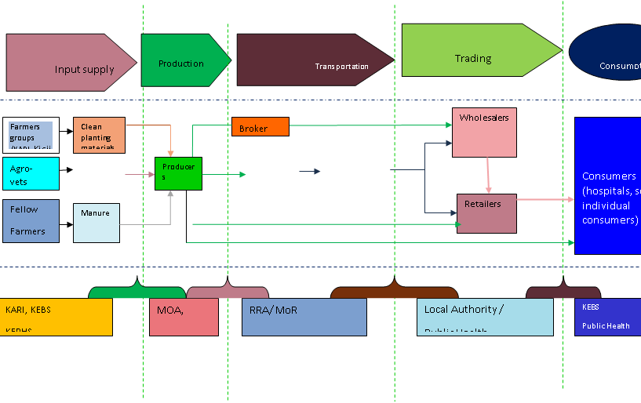
An Example of an Agricultural Commodity Value Chain

Slide 8
Record-keeping or record analysis?
Record-keeping refers to keeping, filing, categorizing and maintaining farm financial and production information.
Record-keeping can be accomplished through a variety of methods, from a basic hand record-keeping method to an elaborate computerized system.
Record analysis refers to evaluating farm records. The evaluation process allows a farm manager to make informed decisions based on actual (or projected) farm performance.

Slide 9
Record Keeping cont..
Obviously, record analysis cannot take place without first keeping records.
Therefore, establishing and using an effective farm record-keeping system for an ongoing farm operation aids
- in farm planning,
-informed decision-making, and
analysis of both production and financial records

Slide 10
Production or financial records?
On the farm, there are two distinct types of records—financial and production.
+Financial records relate primarily to money or the financial interactions of the farm.
+Financial records justify or prove farm income or expense transactions.

Slide 11
Financial records cont..
Product sales, operating expenses, equipment purchases, accounts payable,
+accounts receivable, inventories, depreciation records,
+loan balances and price information are all examples of financial records.

Slide 12
Production records
Production records are items that relate to:
+ quantities of inputs and levels of production by enterprise and/or by resource type.
+They consist of crop yields, plant populations, calves born, pounds of milk produced,
+weaning weights, death loss, etc.
Both production and financial records are important to the efficient management of today’s farm business.

Slide 13
Selecting a recordkeeping system
Selecting a record-keeping system should depend on the expected use of the records.
+ There is no “best” record keeping system for all situations, but, at minimum, a farm records system should:
+provide accurate and necessary information
- fit into the farm organization or framework :
+- be available in a form to aid decisionmaking

Slide 14
Selecting a recordkeeping system cont..
A double-entry accounting system provides the most detailed accounting of farm business transactions.
A significant amount of time is usually needed to learn and implement such a system.
The simpler cash accounting system, with inventory adjustments, will suffice for most farm operations, and is an accepted method of reporting income and expenses for tax purposes

Slide 15
REFERENCES:
Alex Wasonga Dianga , Ken Lohento and Eric Bosire (2020). Supporting and Scaling Up Youth Agripreneurship in Kenya.
Boidurjo Rick Mukhopadhyay. (March, 2020). Agribusiness, Agri-entrepreneurship and Sustainable Intensification
Republic of Kenya. (June, 2012). National Agricultural Sector Extension Policy (NASEP)

